Slide 1
Welcome!

Slide 2
Outline Module 1: Mindset, Market & Message Module 2: Client Attraction Module 3: Get Social Module 4: Big Ticket Sales Secrets Module 5: Strategy Session Framework Module 6: Trust and Conversion
Notes:
Add headline “invite your friends by directing them to:____”

Slide 3
Module #2 Client Attraction
Notes:
Add headline “invite your friends by directing them to:____”

Slide 4
On This Call
Circles of Attraction
Master of Connection
All Roads Lead To Rome

Slide 5
Welcome!
Circles of Attraction

Slide 6
Welcome!
Circles of Attraction

Slide 7
Welcome!
Circles of Attraction
Exposure
Engagement
Experience
Enrollment

Slide 8
Welcome!
Circles of Attraction
Exposure
Engagement
Experience
Enrollment

Slide 9
Welcome!
Circles of Attraction
Exposure
Get Your Audience’s Attention: Stand Out
Networking
Shareable Content
Paid Ads (on and offline)

Slide 10
Welcome!
Assignment #1
List 10 ways your audience can be exposed to you and your brand.
Networking Events
Conferences
Social Media (personal/business page)
Types of Marketing
Interviews

Slide 11
Welcome!
Circles of Attraction
Exposure
Engagement
Experience
Enrollment

Slide 12
Welcome!
Circles of Attraction
Exposure
Engagement
Experience
Enrollment

Slide 13
Welcome!
Circles of Attraction
Experience
In Person - Socially
In Person - Professionally
Website
Public Social Media Profiles
Google

Slide 14
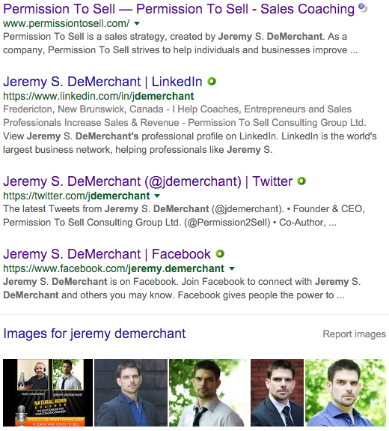
Welcome!
Circles of Attraction

Slide 15
Welcome!
Assignment #2
List 10 ways your audience could be trying to learn more about you and your brand
Website
Google (tip: Google yourself)
Social Media (personal/business page)

Slide 16
Welcome!
Circles of Attraction
Exposure
Engagement
Experience
Enrollment

Slide 17
Welcome!
Circles of Attraction
Exposure
Engagement
Experience
Enrollment

Slide 18
Welcome!
Circles of Attraction
Engagement
Conversations/Interactions
Downloadable content w/ opt-in
Call to action online – “comment below”
Take-away/resume, brochure, business card

Slide 19
Welcome!
Assignment #3
List 10 ways you can engage your audience
In person
On line
Social Media
Website

Slide 20
Welcome!
Circles of Attraction
Exposure
Engagement
Experience
Enrollment

Slide 21
Welcome!
Circles of Attraction
Exposure
Engagement
Experience
Enrollment

Slide 22
Welcome!
Circles of Attraction
Enrollment
Direct Follow Up
Making Offers
Application Processes

Slide 23
Welcome!
Circles of Attraction
Exposure
Engagement
Experience
Enrollment

Slide 24
Welcome!
Master of Connection

Slide 25
Welcome!
Master of Connection
Bridge The Gap
Make it easy for your audience to move through the Circles of Attraction
Be easily found
Make next steps clear

Slide 26
Welcome!
Master of Connection
Own the follow up
Personal connection will expedite the process
Make offers to inspire action
Tip: Always have a system to organize and follow up with your contacts

Slide 27
Welcome!
Assignment #4
Decide on a system to organize your contacts
In person
On line

Slide 28
Welcome!
All Roads Lead To Rome

Slide 29
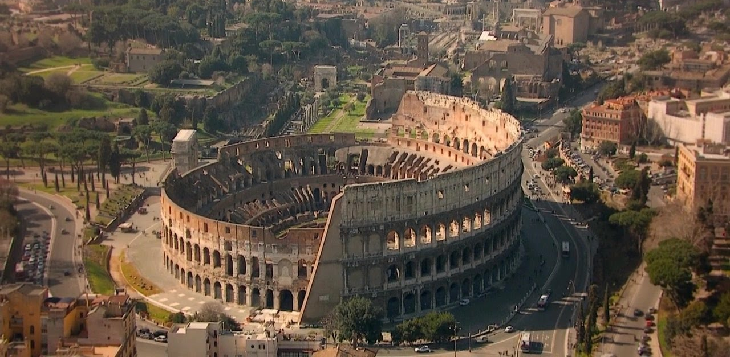
Welcome!
All Roads Lead To Rome

Slide 30
Welcome!
All Roads Lead To Rome
Clients can come from anywhere
It’s our job to guide them to where we want them to go
Create 1 or 2 key “hubs” in your business
Tip: Always have a system to track where your contacts came from
Direct all traffic to the hub

Slide 31
Welcome!
All Roads Lead To Rome
Your
Business

Slide 32
Welcome!
Assignment #5
Decide on a single hub for your contacts

Slide 33
Welcome!
Assignments
List 10 ways your audience can be exposed to you and your brand.
List 10 ways your audience could be trying to learn more about you and your brand
List 10 ways you can engage your audience
Decide on a system to organize your contacts
Decide on a single hub for your contacts
Get Clear on Your Big 3 and Post in the FB Group
Get Clear on Your Key 3 for this week and Post in the FB Group

