Slide 1
Welcome!

Slide 2
Outline Module 1: Mindset, Market & Message Module 2: Client Attraction Module 3: Get Social Module 4: Big Ticket Sales Secrets Module 5: Strategy Session Framework Module 6: Trust and Conversion
Notes:
Add headline “invite your friends by directing them to:____”

Slide 3
Module #3 Get Social
Notes:
Add headline “invite your friends by directing them to:____”

Slide 4
On This Call
Social Networks Powerful Profiles
Sharing Content
Paid Traffic

Slide 5
Welcome!
Social Networks

Slide 6
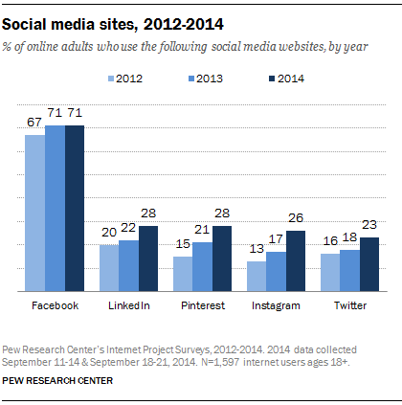
Welcome!
Social Networks

Slide 7
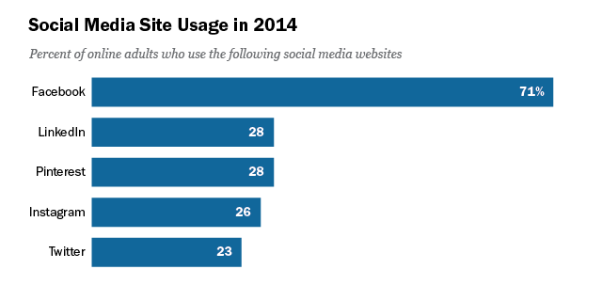
Welcome!
Social Networks

Slide 8
Welcome!
Powerful Profiles
Facebook Profile (Personal)
Facebook Fan Page (Business)
LinkedIn Profile (Personal)

Slide 9
Welcome!
Powerful Profiles
Your prospect’s first introduction to you
What does it tell them?
Where does it direct them?

Slide 10
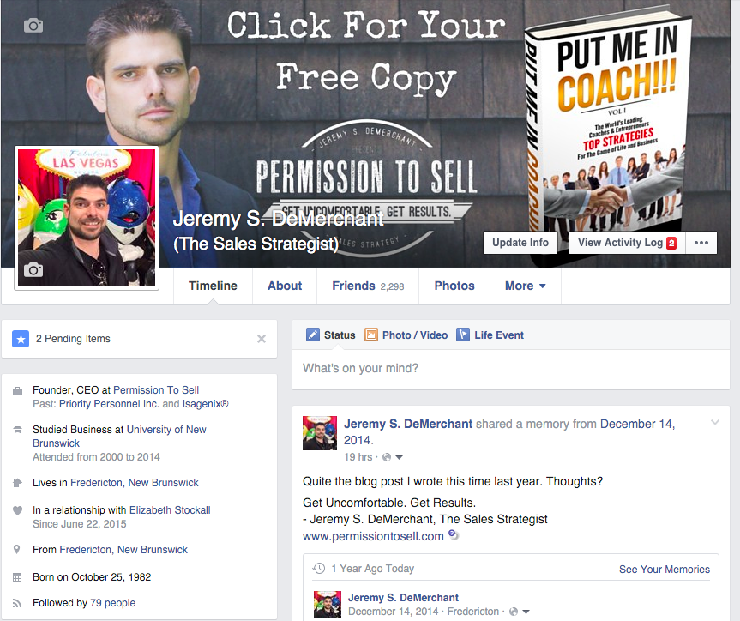
Welcome!
Powerful Profiles

Slide 11
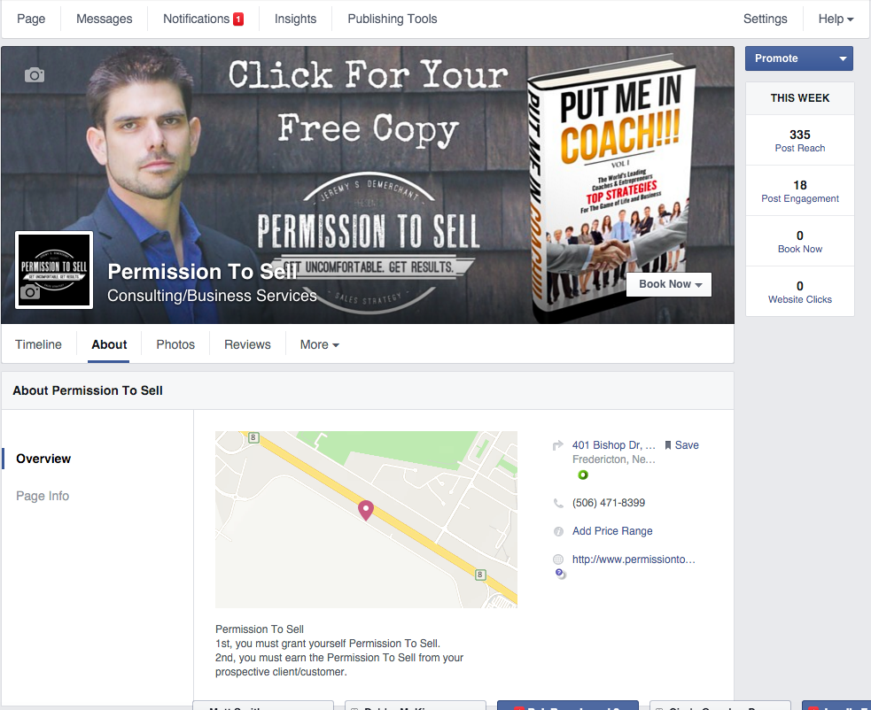
Welcome!
Powerful Profiles

Slide 12
Welcome!
Powerful Profiles

Slide 13
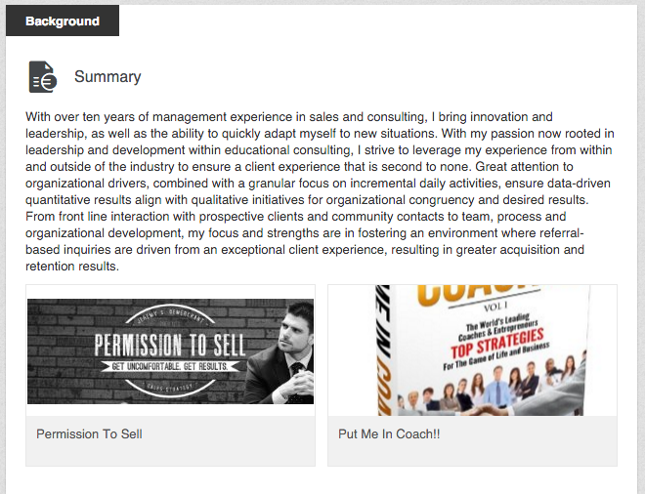
Welcome!
Powerful Profiles

Slide 14
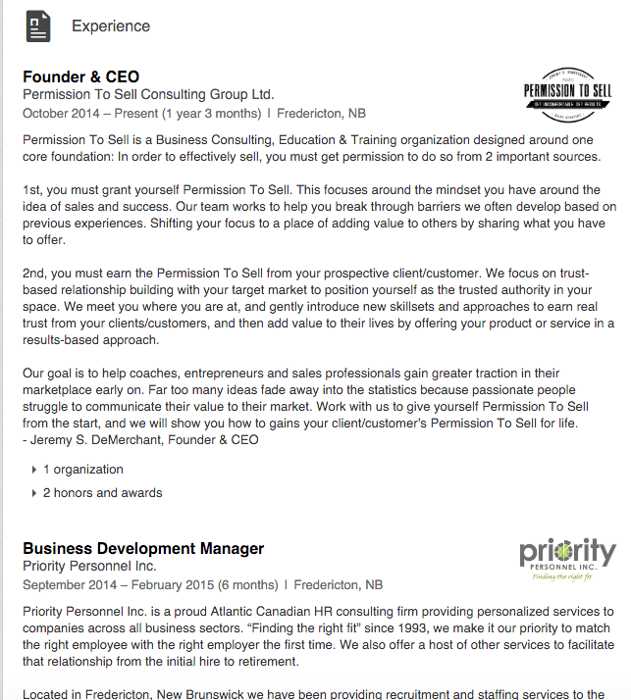
Welcome!
Powerful Profiles

Slide 15
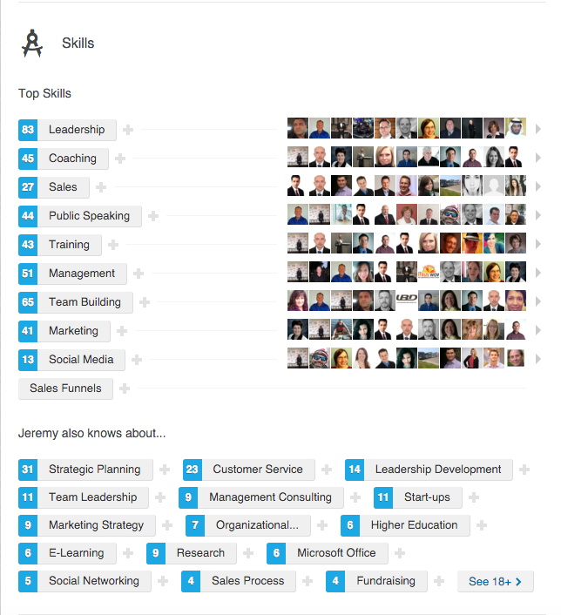
Welcome!
Powerful Profiles

Slide 16
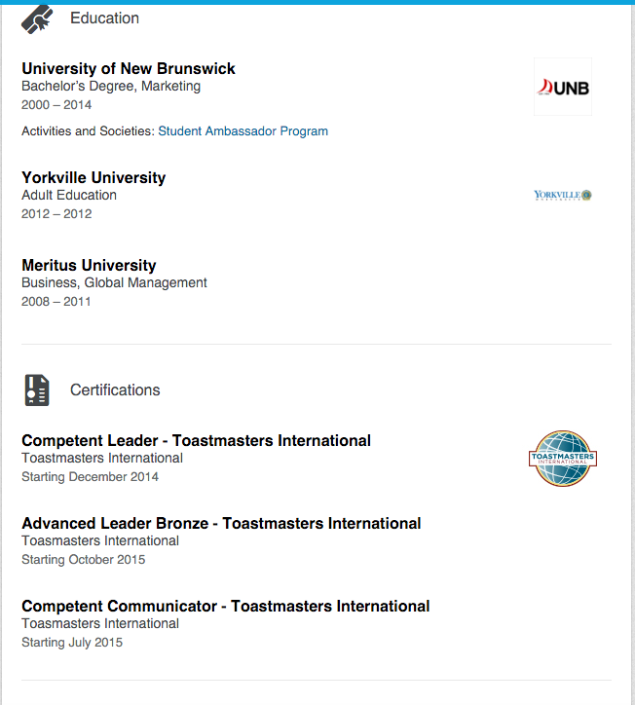
Welcome!
Powerful Profiles

Slide 17
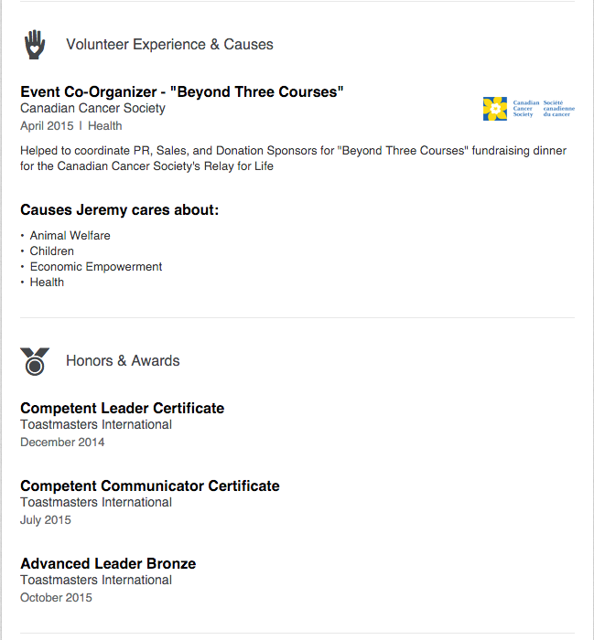
Welcome!
Powerful Profiles

Slide 18
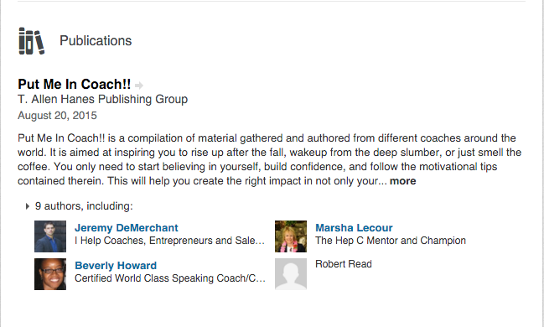
Welcome!
Powerful Profiles

Slide 19
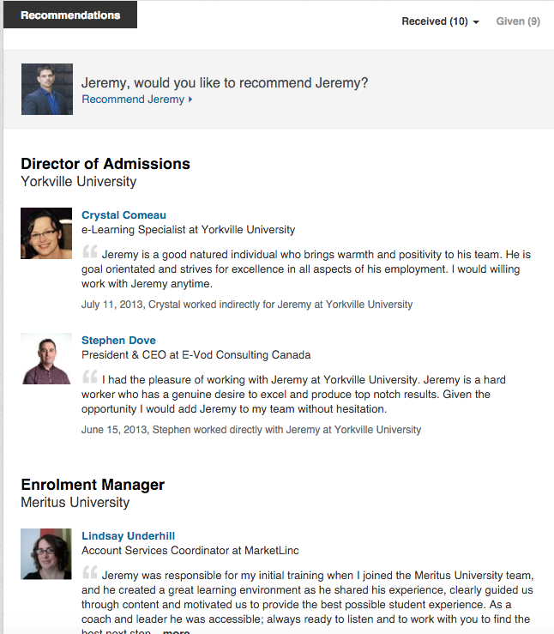
Welcome!
Powerful Profiles

Slide 20
Welcome!
Sharing Content

Slide 21
Welcome!
Sharing Content
Deliver value
Blog vs. Facebook vs. LinkedIn
Tagging

Slide 22
Welcome!
Sharing Content
Facebook Groups

Slide 23
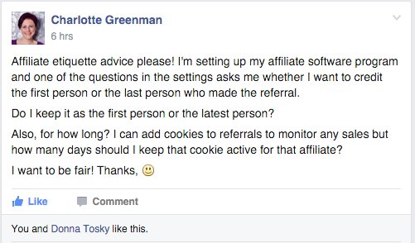
Welcome!
Sharing Content
Facebook Groups

Slide 24
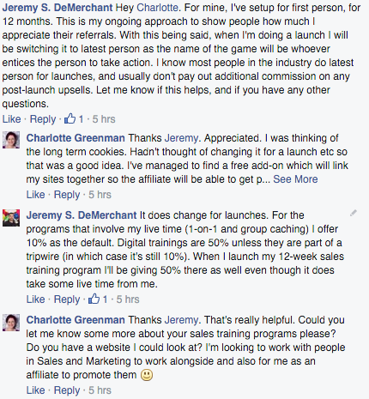
Welcome!
Sharing Content
Facebook Groups

Slide 25
Welcome!
Paid Traffic

Slide 26
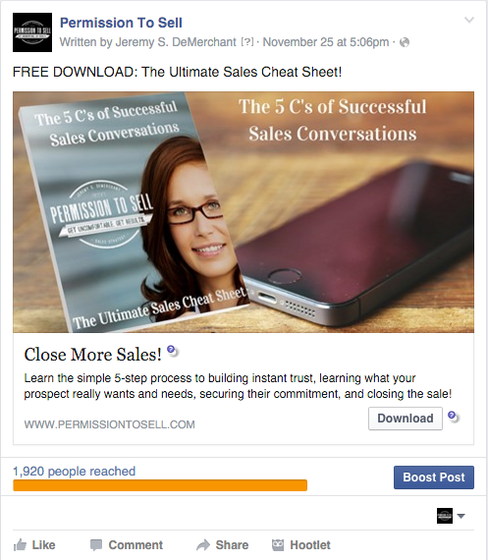
Welcome!
Paid Traffic

Slide 27
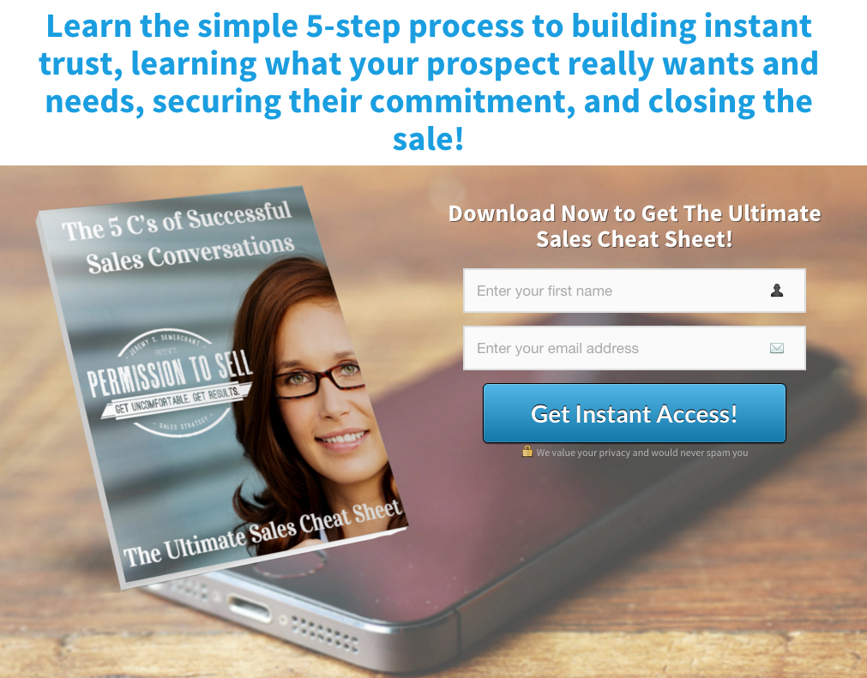
Welcome!
Paid Traffic

Slide 28
Welcome!
Paid Traffic

Slide 29
Welcome!
Bonus Tool
Canva.com

Slide 30
Welcome!
All Roads Lead To Rome

Slide 31
Welcome!
Assignments
Choose you #1 social media platform.
Update your profile on all platforms
Identify 3 ways you can deliver content
Decide on a single hub for your contacts
Get Clear on Your Big 3 and Post in the FB Group
Get Clear on Your Key 3 for this week and Post in the FB Group

