Slide 1
Welcome!

Slide 2
Outline Module 1: Mindset, Market & Message Module 2: Client Attraction Module 3: Get Social Module 4: Big Ticket Sales Secrets Module 5: Strategy Session Framework Module 6: Trust and Conversion
Notes:
Add headline “invite your friends by directing them to:____”

Slide 3
Module #4 Big Ticket Sales Secrets
Notes:
Add headline “invite your friends by directing them to:____”

Slide 4
On This Call
Posture
5 Simple Steps for Big Ticket Sales Conversations
Presenting The Investment
Continuous Improvement

Slide 5
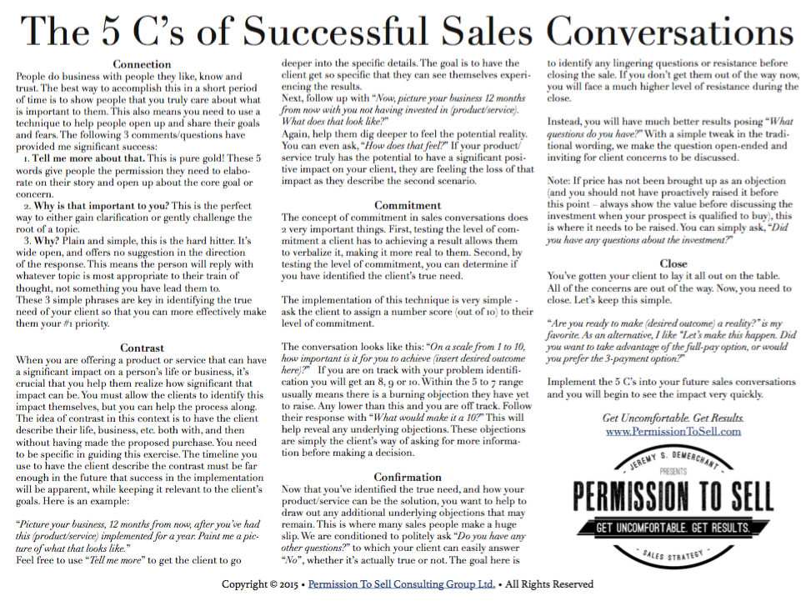
Download This

Slide 6
Welcome!
Posture
“Sales is finding out what someone DOES want or need, and then helping them to get it”
– Bob Burg

Slide 7
Welcome!
Posture
Keep Score of the people you help at the highest level, not the number of sales you close.

Slide 8
Welcome!
Posture
It’s your obligation to get your services in the hands of the people that NEED them.

Slide 9
Welcome!
Posture
Detach yourself from the outcome.

Slide 10
Welcome!
5 Simple Steps for Big Ticket Sales Conversations

Slide 11
Welcome!
5 Simple Steps for Big Ticket Sales Conversations
Connection
Contrast
Commitment
Confirmation
Close

Slide 12
Welcome!
Connection
“Tell Me More About That”
“Why is that important to you?”
“Why?”

Slide 13
Welcome!
Contrast
Significant Impact
“What does your ____ look like 5 years from now with (product or service)?”
“What does your ____ look like 5 years from now without (product or service)?”
“How does that feel?”

Slide 14
Welcome!
Commitment
“On a scale from 1 to 10, how important is it for you to achieve (insert desired outcome here)?”
8-10 – “What does it take to make it a 10?”
5-7 – burning objection
Below 5 – off the mark

Slide 15
Welcome!
Confirmation
“What questions do you have?”

Slide 16
Welcome!
Close
Keep it simple
“Are you ready to make (desired outcome) a reality?”
“Let’s make this happen. Did you want to take advantage of the full-pay option, or would you prefer the 3-payment option?”

Slide 17
Welcome!
5 Simple Steps for Big Ticket Sales Conversations
Connection
Contrast
Commitment
Confirmation
Close

Slide 18
Welcome!
Assignment #1
Role play through the 5C’s of Successful Sales Conversations with someone acting as your ideal client.

Slide 19
Welcome!
Presenting The Investment
Pricing will always come up in the “confirmation” stage of the sales conversation.

Slide 20
Welcome!
Presenting The Investment
Present the investment with posture and confidence.
You must be clear on your pricing before entering in the sales conversation.
Have 2-3 package options.

Slide 21
Welcome!
Presenting The Investment
Practice presenting your pricing.
Eg. “The investment for the ____ package is $XX,XXX or if you wish to pay in full you’ll save XX%” Eg. “The investment for the ___ package is $XXX/month over XX months, or you can pay upfront to (get 2 months free/save xx%)

Slide 22
Welcome!
Presenting The Investment
After you present the investment, BE SILENT.
DO NOT interrupt the prospects decision making process!

Slide 23
Welcome!
Assignment #2
Write a script for presenting the investment for your program & role play (including the silence after the offer).

Slide 24
Welcome!
Continuous Improvement
Evaluate every call.
Was the prospect qualified?
Was the prospect committed to achieving results?
What could you have done differently?

Slide 25
Welcome!
Assignment #3
Create a checklist of what “qualifiers” are necessary for your ideal client
Use this to create an application to filter who you invest your time with

Slide 26
Welcome!
Assignments
Role play sales conversations for your programs
Write a script for presenting the investment for your offer, practice and role play
Create a checklist of what “qualifiers” are necessary for your ideal client and create application
Get Clear on Your Big 3 and Post in the FB Group
Get Clear on Your Key 3 for this week and Post in the FB Group

